Slide 1



COMPSCI 326
Join on Zoom if you are remote (see Moodle for link).
Lecture 01: Course Introduction

Slide 2
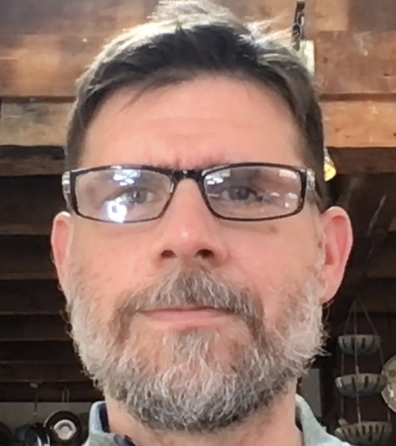
Announcements
We need a notetaker(s) for this course!
If you are interested, please communicate with the course staff on Piazza by posting a note to Instructors. (perhaps a form?)

Slide 3
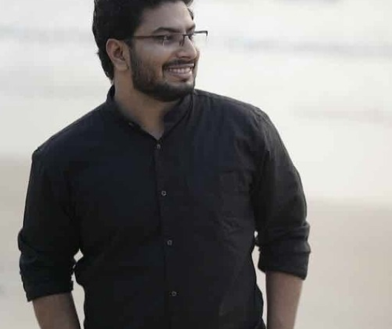

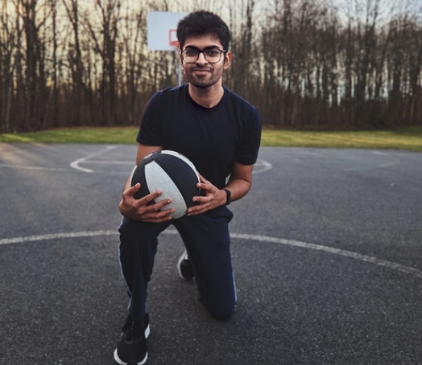
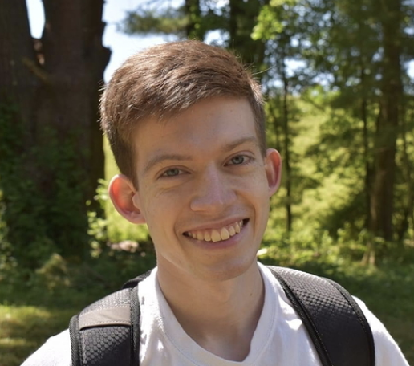
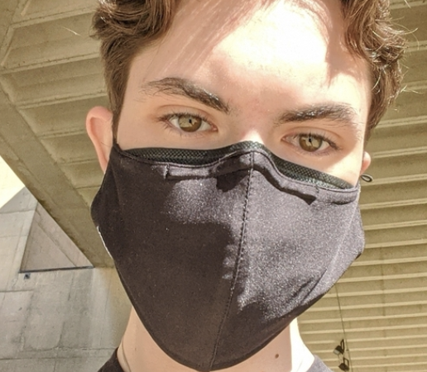
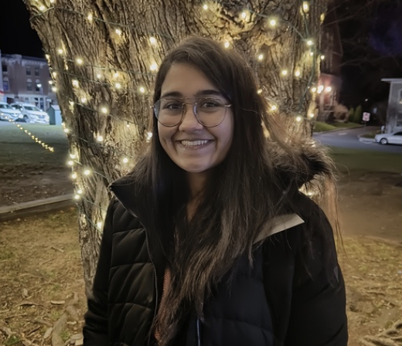
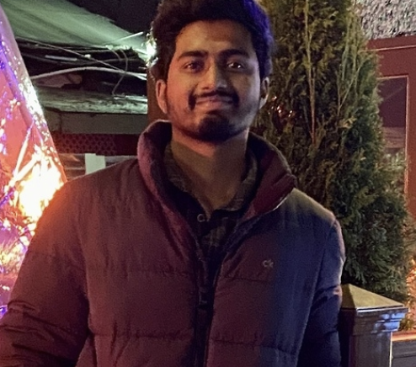
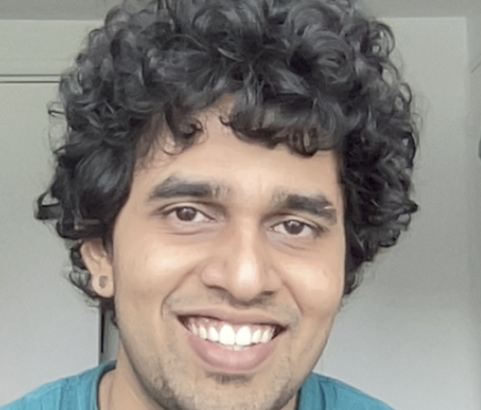
Welcome!
Welcome to COMPSCI 326 Web Programming!
Arjun Karuvally (TA)
Erin Liu (TA)
Pratik Mulchandani (Grader)
Tim Richards (Instructor)
Tim Richards completed his Phd and Masters in Computer Science at UMass Amherst in 2010. His research work involved programming languages, compiler back-ends, operating systems, and verification of instruction set architectures. He has taught web programming for a decade or so. He loves teaching all things related to web systems!
Bryce Parkman (UCA)
Nic Asnes (UCA)
Purva Jhaveri (Grader)
Nikhil Kagita (Grader)
Vignesh Radhakrishna (Grader)

Slide 4
Lecture Time/Format
This course is a hybrid course
Section 01: Tuesday from 4:00 PM - 5:15 PM
If you are enrolled in Section 01, you attend in person
If you are enrolled in Section 02, you attend remote synchronous/asynchronous
Section 02: Thursday from 1:00 PM - 2:15 PM
If you are enrolled in Section 02, you attend in person
If you are enrolled in Section 01, you attend remote synchronous/asynchronous
We will use Zoom for remote synchronous attendance.
We will use Zoom to record all lectures.
See Website for Zoom invitation links.

Slide 5
Lab Time/Format
Erin Liu
Arjun Karuvally
Bryce Parkman
Nic Asnes (UCA)
Lab 01LL: Friday 10:10 AM - 11:00 AM (Marston Hall room 132)
Lab 01LM: Friday 11:15 -AM 12:05 PM (Ag. Engineering Bldg rm 119)
Lab 02LL: Friday 12:20 PM - 1:10 PM (Engineering Laboratory rm 303)
Lab 02LM: Friday 1:25 PM - 2:15 PM (Engineering Laboratory rm 303)
You are required to attend the lab you are enrolled in.
If you are unable to attend lab in-person, you may opt to join through zoom.
The labs will be remote synchronous for the first couple of weeks.

Slide 6

Agenda
Where do I find stuff?
Moodle
Website
How do we communicate?
Slack
Course Administration
Syllabus
Calendar
What is this course about?
Web Programming

Slide 7

Moodle
This is the place where you should start.
Link to the course website
Slack sign-up information
Zoom links (also found on website)

Slide 8
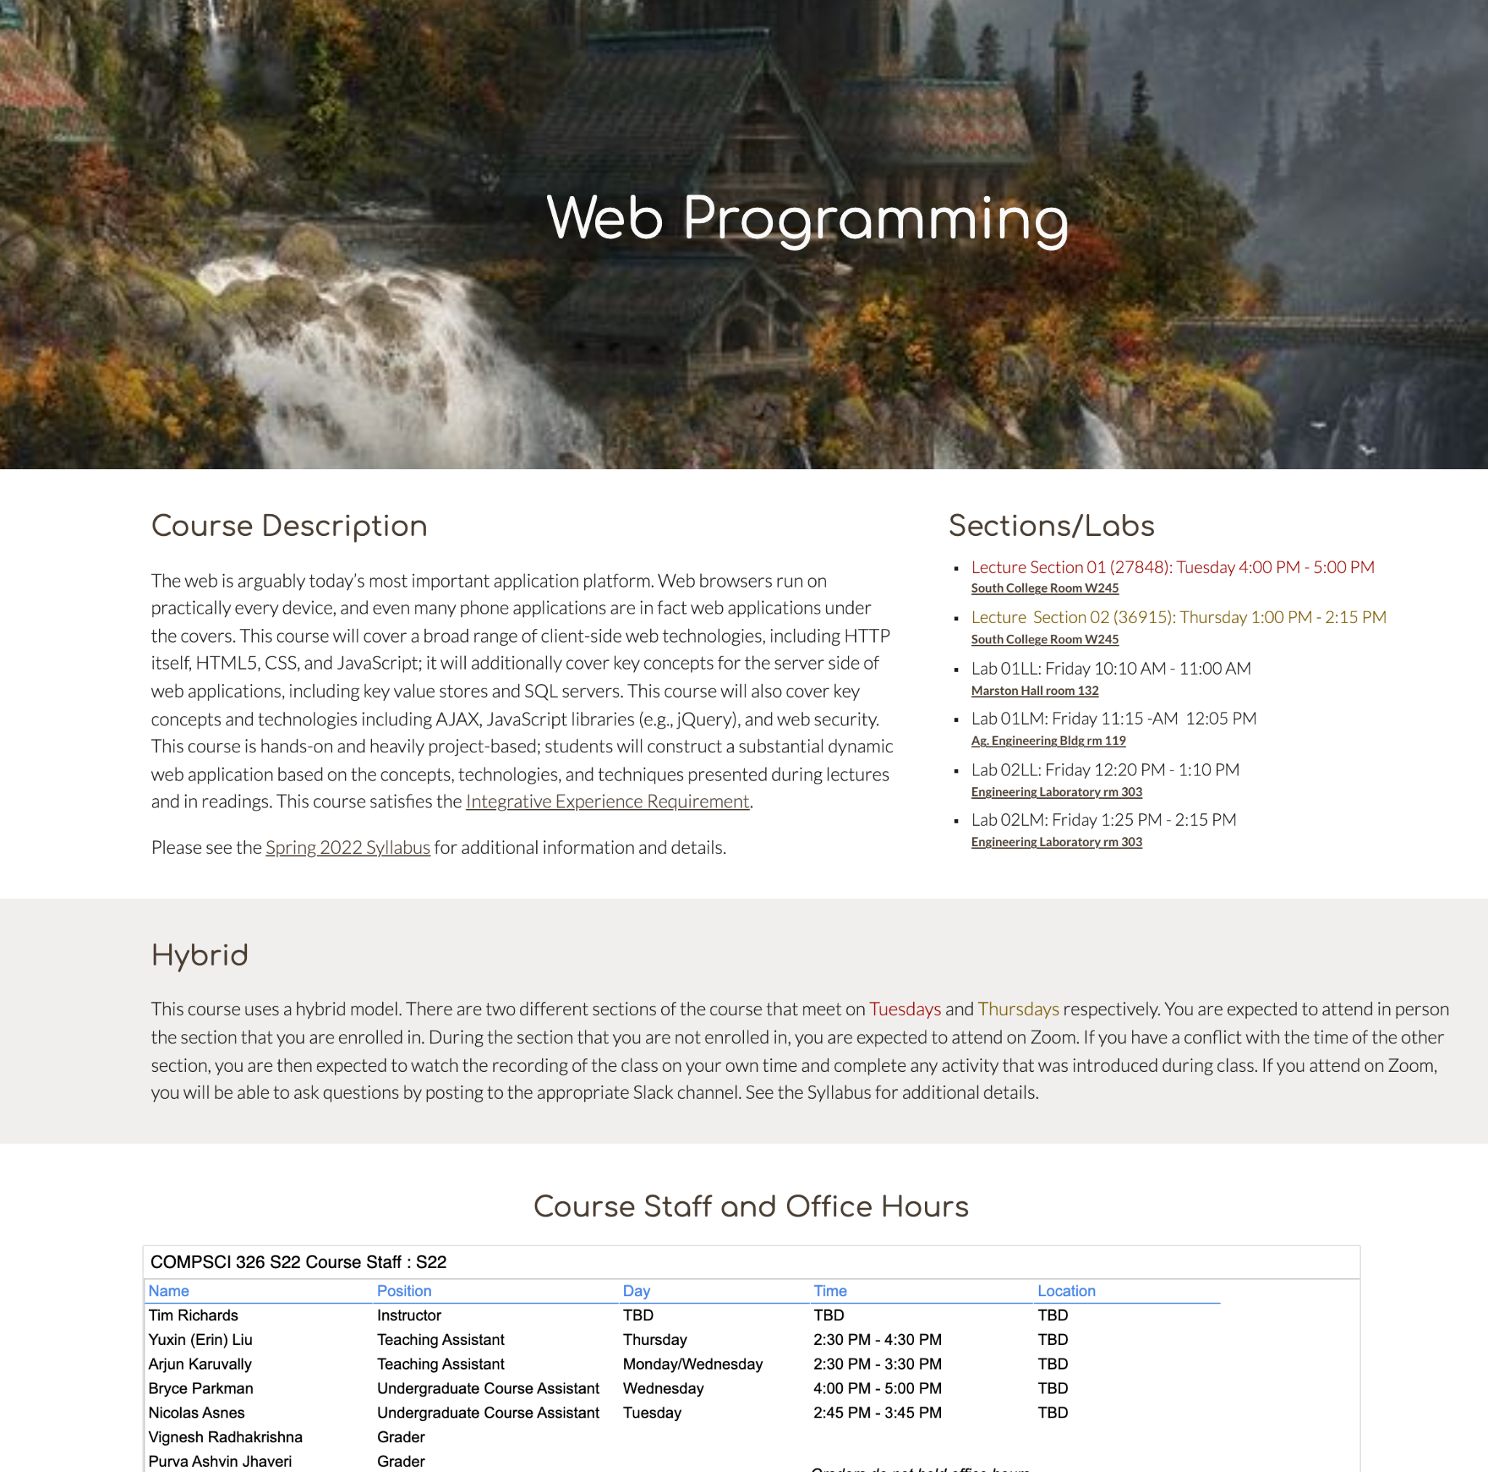
Website
The course website is the primary source of information for this course.
The date, time, and location of lecture
The date, time, and location of lab
The course staff and office hours
The schedule, which includes links to relevant material, assignments, and deadlines

Slide 9
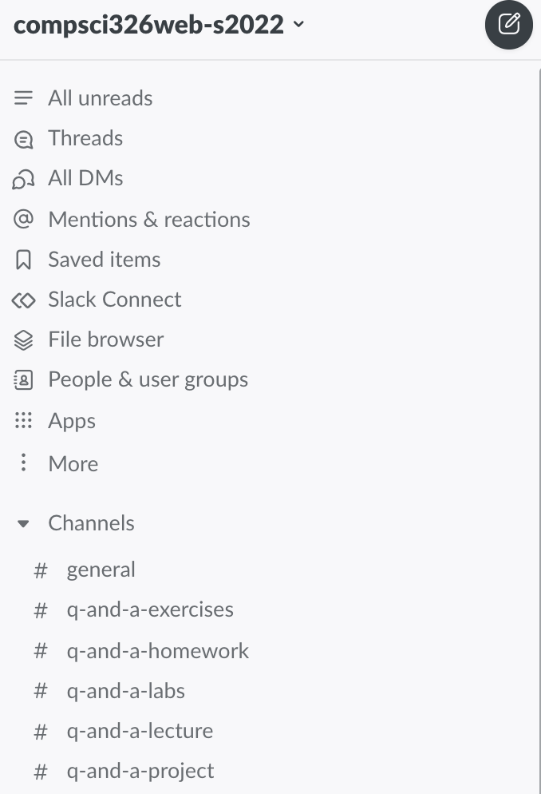
Slack
We will communicate using Slack
Material and assignments will be posted to Slack
This is where you will be able to ask questions about material and assignments
You should mostly post publicly
Private DM posts are reserved for specific questions about your code or extenuating circumstances
See the syllabus for details on which channel to post to

Slide 10
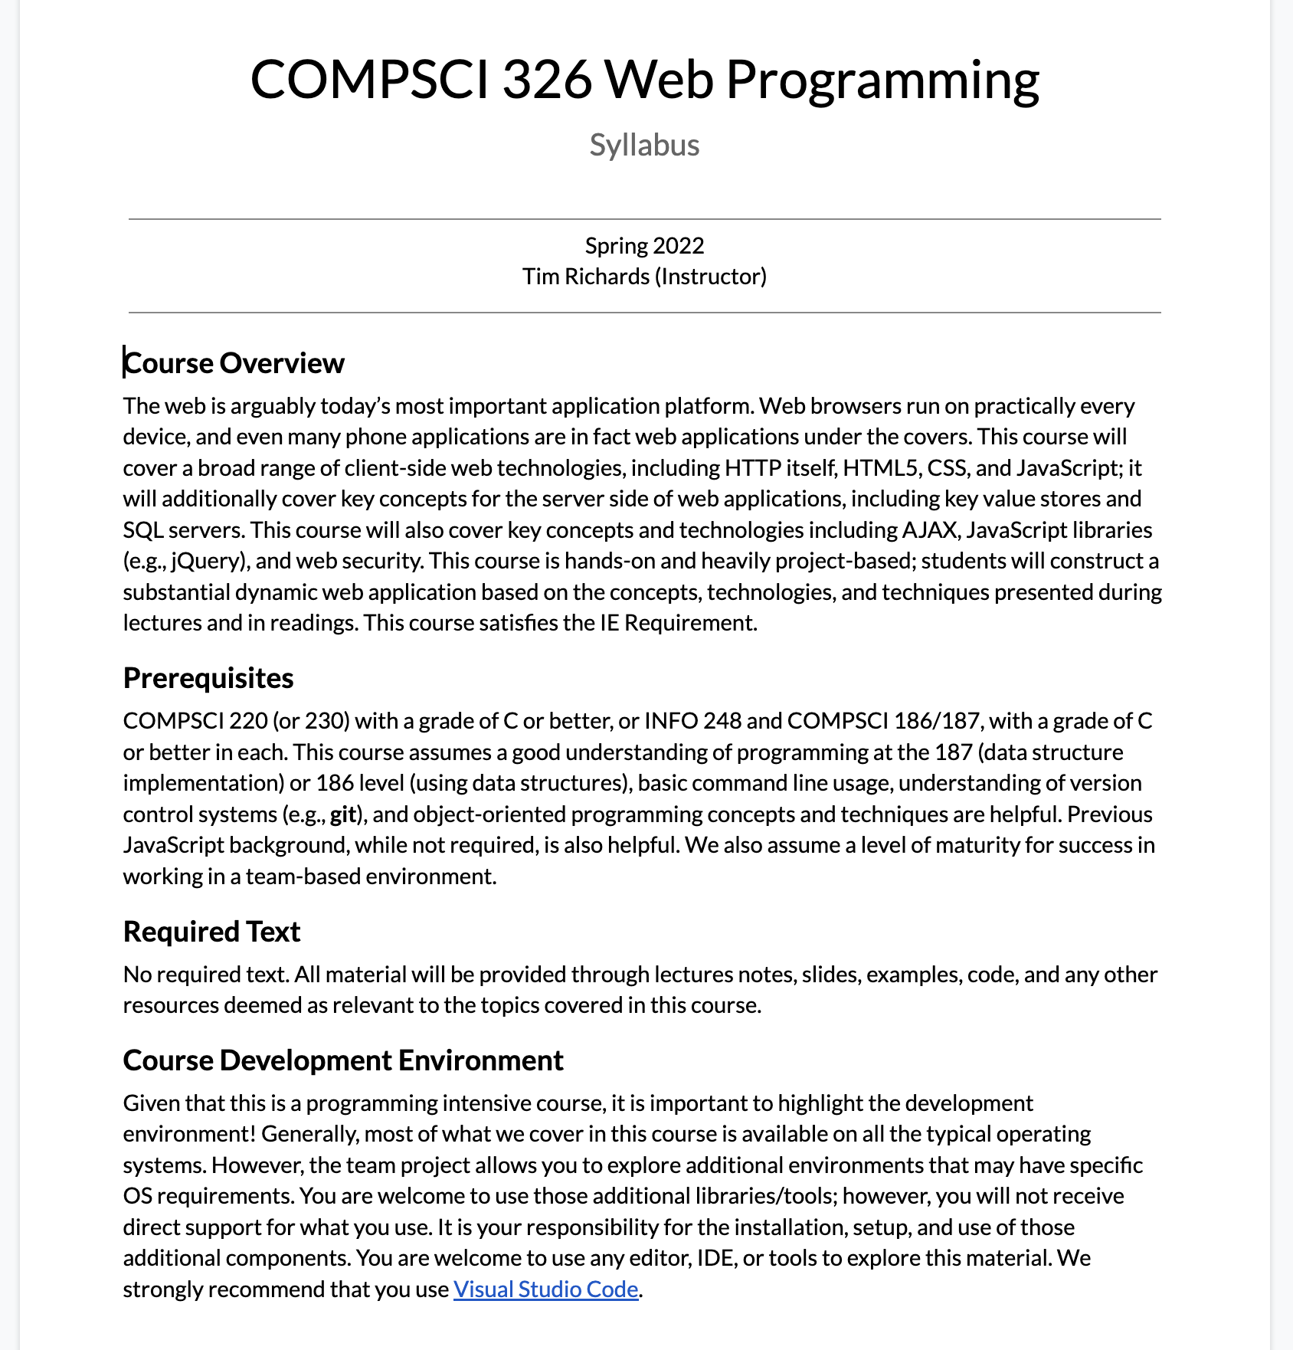
Syllabus
The syllabus is the primary resource for all details regarding the course
You should consult the syllabus for all aspects of the course
There may be circumstances where the syllabus needs to be updated, so always visit the syllabus online to ensure you are reading the most updated information

Slide 11
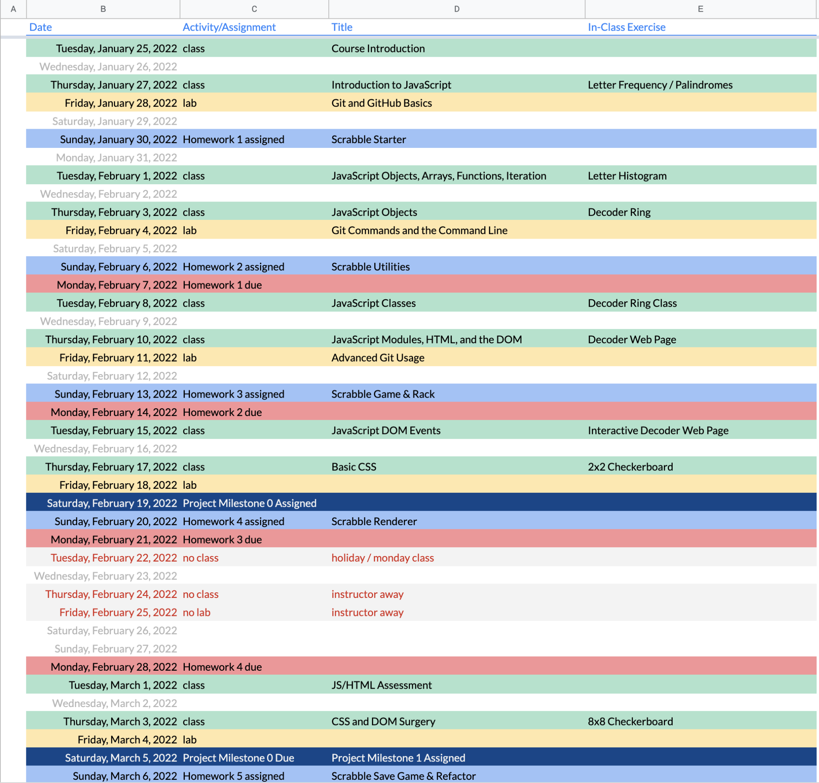
Calendar
The calendar provides a complete schedule for the course.
You should consult the schedule to know what topics are being covered and when assignments are assigned and due.
There may be circumstances where the calendar needs to be updated, so always visit the calendar online to ensure you are reading the most updated information

Slide 12
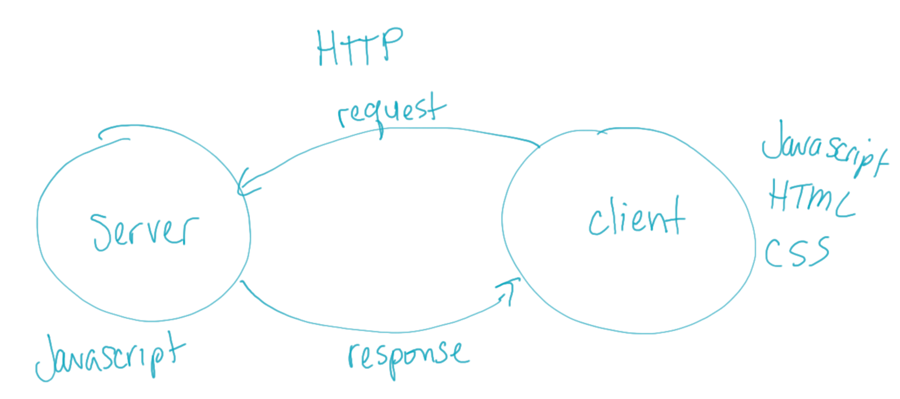
What is this course about?
Web Programming
JavaScript
HTML
CSS
Hypertext Transfer Protocol (HTTP)
Client programs
Server programs

Slide 13
Academic Honesty Pledge
Academic honesty is taken seriously as part of being a member of the CICS community. As an active member of this course you are required to sign a pledge that you will uphold the values and trust of our community and commit to honesty and integrity in all assignments, exams, and activities. This pledge also acknowledges the consequences of breaking this trust and accepting the results of your actions.
The Pledge: https://forms.gle/RhFEnW7cemurj4L8A

Slide 14
In-Class Activity
Part 1
Please fill out the following form:
https://forms.gle/BqrxDxgcfoPFP6vH8
We are using this form to collect information about your background. This will help us gauge where we may need to provide you with additional support.
This is a graded activity. That is, you must fill it out to get credit.
Part 2
We will be using Node.js in this course. It is a JavaScript backend environment that is particularly excellent for writing HTTP servers.
Your task is to download and install Node.js.
There is no submission for this.
All in-class activities are due the following day by midnight.

Slide 15

The End

